Slide 1
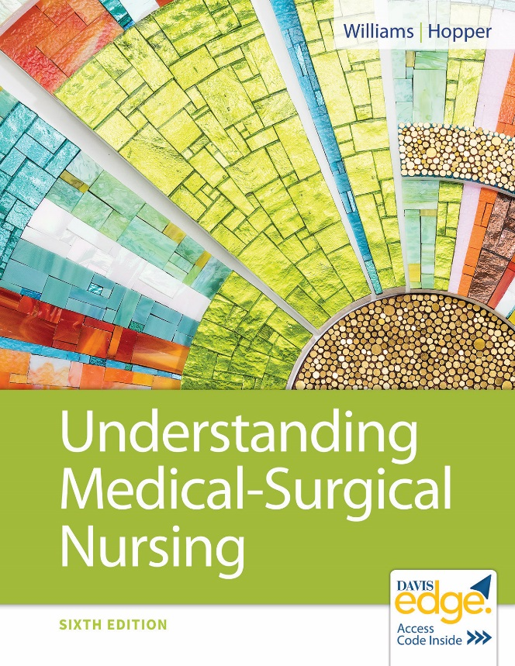

Chapter 27
Hematological and Lymphatic System Function, Assessment, and Therapeutic Measures

Slide 2
Learning Outcomes
List the components of blood.
List the components of the lymphatic system.
Describe how changes in the blood or lymph systems can manifest as disease processes.
Describe the sequence of events in the process of blood clotting.

Slide 3
Learning Outcomes (continued_1)
Identify data to collect when caring for a patient with a disorder of the hematological or lymphatic system.
Identify laboratory and diagnostic studies that are used when evaluating the hematological and lymphatic systems.
Plan nursing care for patients undergoing diagnostic tests of the hematological or lymphatic systems.

Slide 4
Learning Outcomes (continued_2)
List common therapeutic measures used for patients with hematological and lymphatic disorders.
Discuss the role of the licensed practical nurse/licensed vocational nurse (L P N/L V N) in administering blood products.

Slide 5
Review of Anatomy and Physiology
Hematological system
Bone marrow
Blood and blood components
Lymphatic system
Lymph nodes
Nodules
Lymph vessels
Notes:
Please refer to figure 27.1, page 511, system of lymph vessel.

Slide 6
Blood
Consists of
Plasma
Red blood cells (R B C’s)
White blood cells (W B C’s)
Platelets
Functions include
Transporting substances
Regulating body temperature, p H, and fluid balance
Transporting cells that offer the body protection
Notes:
Please refer to figure 27.1, page 511, system of lymph vessel.

Slide 7
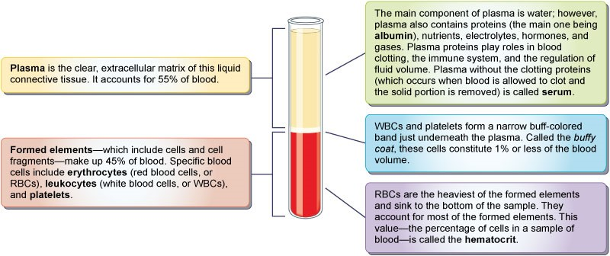
Components of Blood

Slide 8
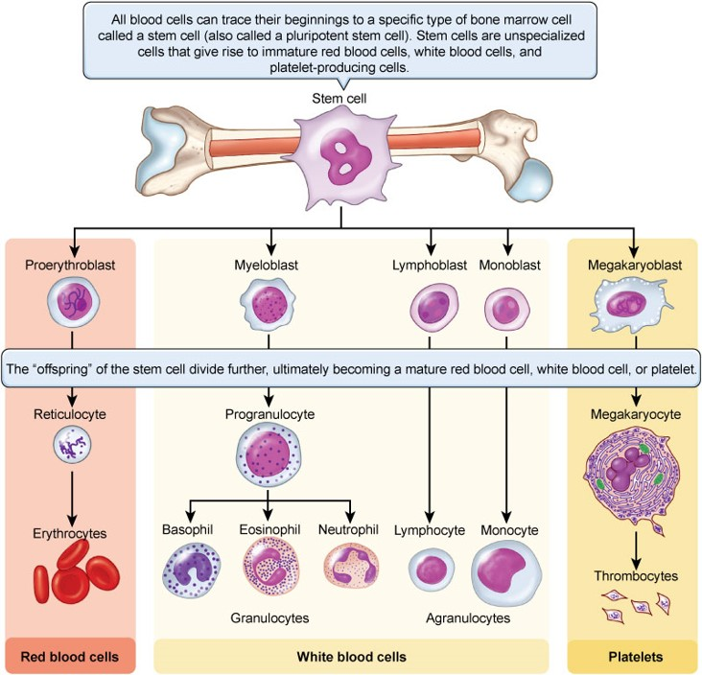
Blood Cell Formation

Slide 9
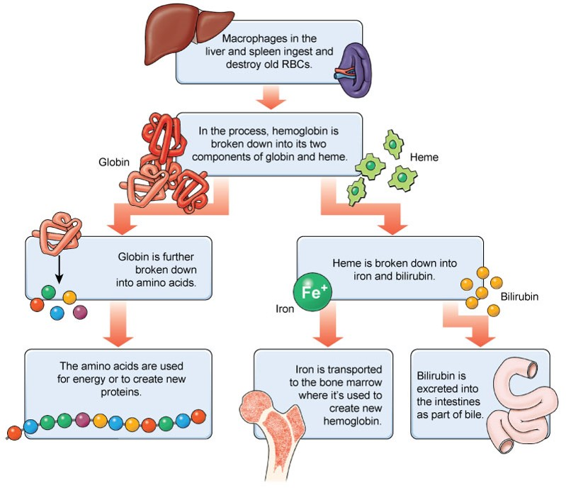
Breakdown of R B C’s

Slide 10
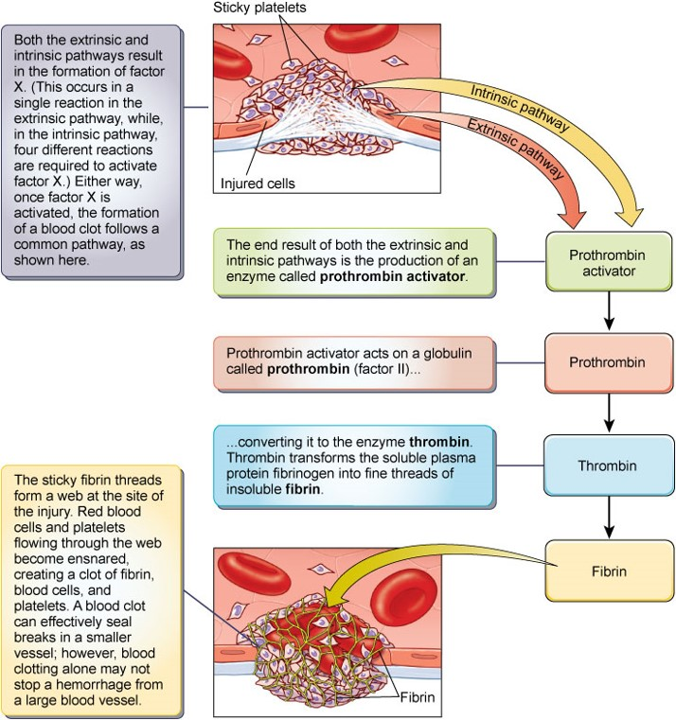
Formation of a Blood Clot

Slide 11
Lymphatic System
Consists of
Lymph
Lymph nodes and nodules
Lymph vessels
Spleen
Thymus
Functions include
Returning tissue fluid to maintain blood volume
Protecting the body against pathogens and other foreign material

Slide 12
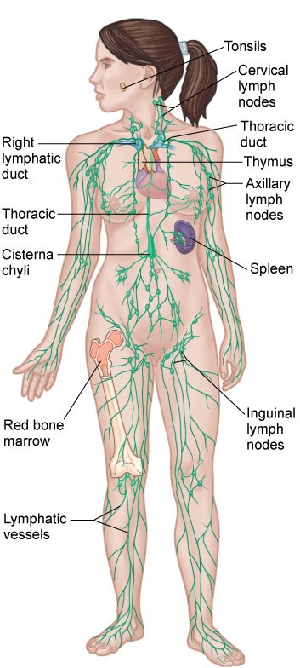
Lymphatic System (continued)

Slide 13
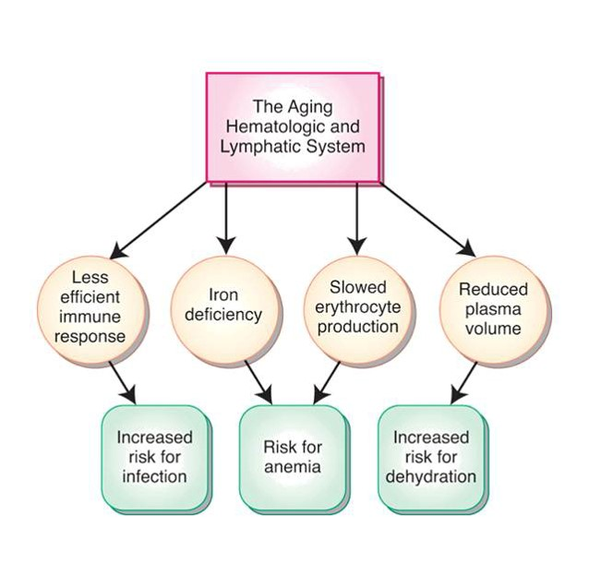
Aging Changes

Slide 14
Health History
Reason for seeking care
Family history
Diet history
Medications
Occupational/exposure
Fatigue
Bleeding tendencies
Respiratory symptoms
Skin changes
Lymphadenopathy

Slide 15
Physical Assessment
Vital signs
Level of consciousness
Skin color
Signs of bleeding
Lymph nodes
Fingernails
Abdomen

Slide 16
Diagnostic Tests
Blood tests
Coagulation tests
Bone marrow biopsy
Lymphangiography
Lymph node biopsy

Slide 17
Blood Products
Packed R B C’s
Frozen R B C’s
Platelets
Albumin
Fresh frozen plasma
Cryoprecipitates

Slide 18
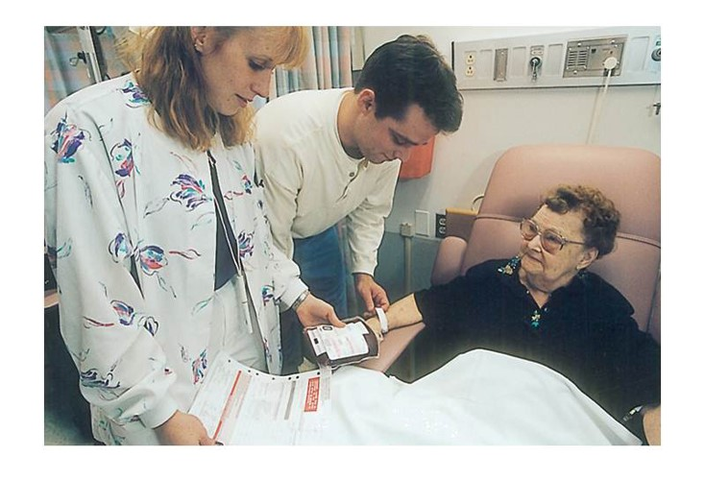
Transfusion Safety Steps
Assessment
Identification
Use only normal saline
Filtering
Washing
Warming

Slide 19
Transfusion Complications
Febrile reaction
Urticarial reaction
Hemolytic reaction
Anaphylactic reaction
Circulatory overload

Slide 20
Review Question
Which cells form platelets?
Reticulocytes
Progranulocytes
Monoblasts
Megakaryocytes

Slide 21
Review Question Answer
Correct Answer: 4

Slide 22
Review Question (continued_1)
What is a normal W B C count per millimeters³?
450 to 1,000
1,200 to 1,500
4,500 to 11,000
12,000 to 18,000

Slide 23
Review Question Answer (continued_1)
Correct Answer: 3

Slide 24
Review Question (continued_2)
What is the function of the spleen?
Select all that apply.
Stores platelets
Produces clotting factors
Removes old R B C’s from circulation
Stores bile
Contains lymphocytes and macrophages

Slide 25
Review Question Answer (continued_2)
Correct Answer: 1, 3, 5

Slide 26
Review Question (continued_3)
Which term is used to describe pinpoint bleeding into the skin?
Bruising
Ecchymoses
Purpura
Petechiae

Slide 27
Review Question Answer (continued_3)
Correct Answer: 4

Slide 28
Review Question (continued_4)
Which I V solution must be used with a blood transfusion to prevent complications?
Lactated Ringer’s solution
5% dextrose in water
5% dextrose in 0.45% saline
Normal saline

Slide 29
Review Question Answer (continued_4)
Correct Answer: 4

